Slide 1
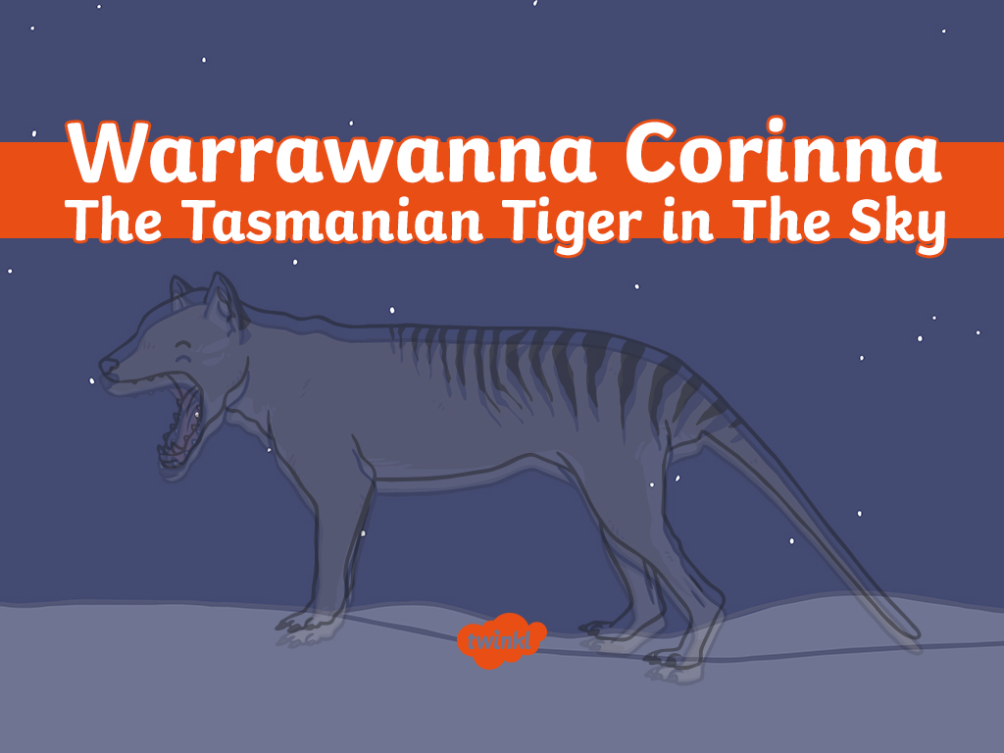

Slide 2
Indigenous people of Tasmania tell the story of Warrawanna Corinna, the Tasmanian Tiger.
This is a story about a boy named Palana. He was the son of the great god Moihernee. Moihernee lived in the sky among the stars. The bush was a happy, exciting and wild place for Palana.

Slide 3
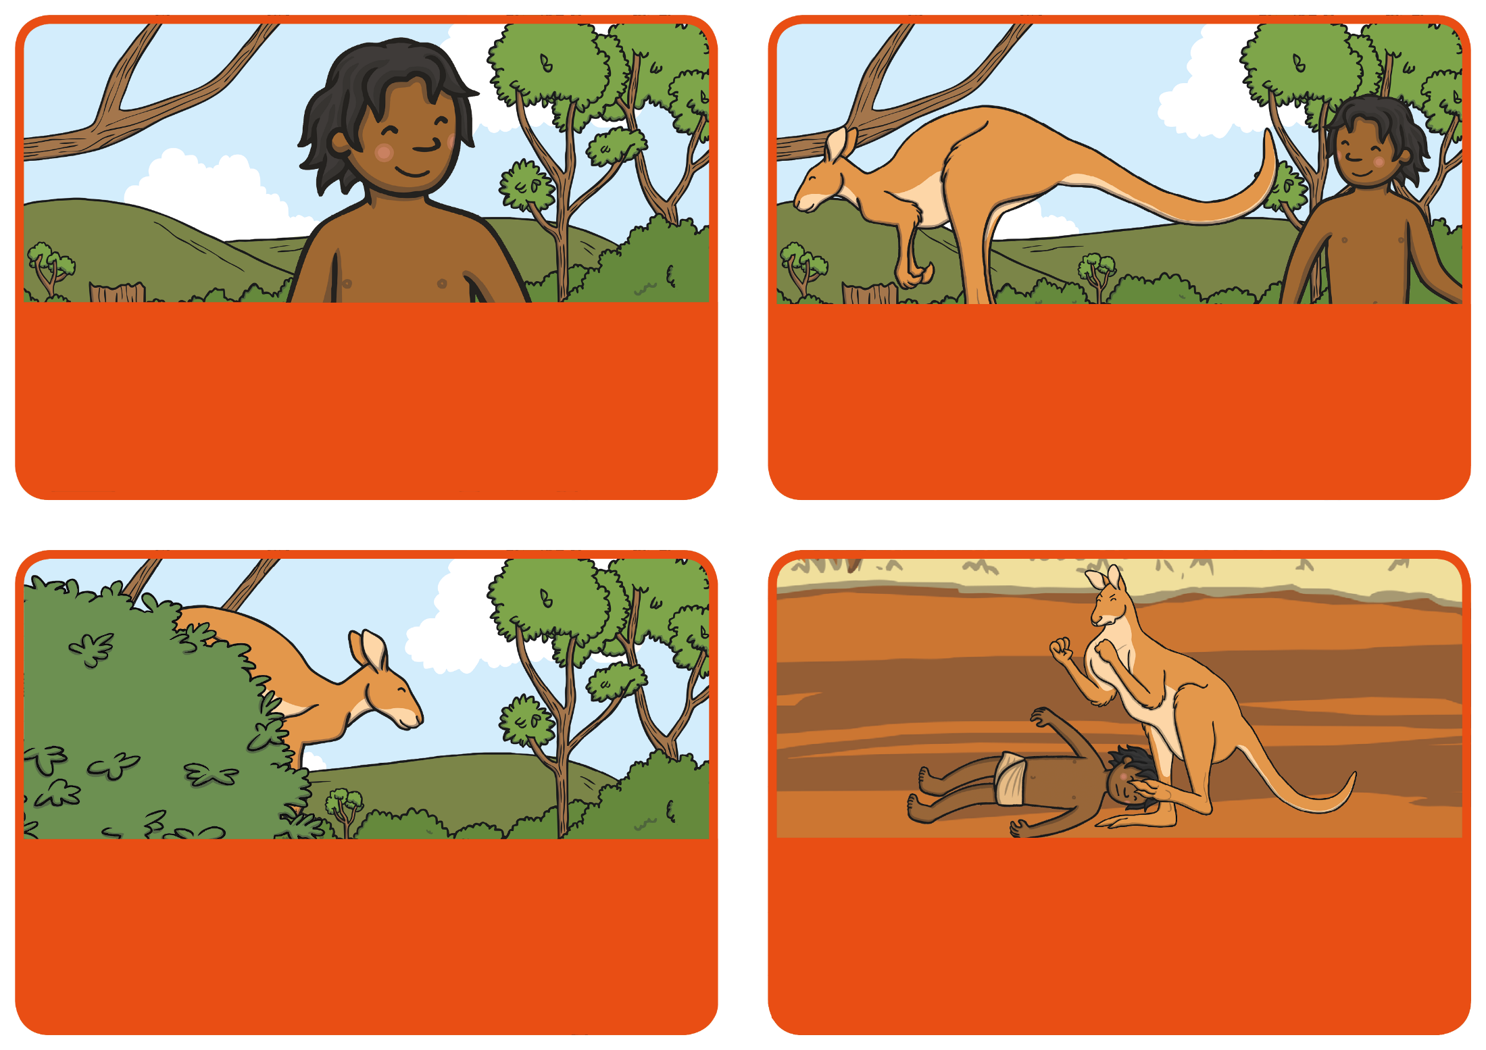
One day, he was on one of his many adventures in the bush. Just like he so often did, he was searching for animals and watching them go about their business. Then he saw a big kangaroo and wanted to track it. Its name was Tarner, and he looked very big and very strong.

Slide 4
Palana kept following Tarner and getting closer and closer to him. The kangaroo knew Palana was tracking him and so he thought it was time to teach the boy a lesson. Tarner hid behind some trees and then jumped out and grabbed Palana.

Slide 5
The kangaroo began jumping on Palana with his huge feet and hitting him with his strong tail. Palana was being attacked and he couldn’t fight back! So, he began crying out. Palana yelled for someone to help him. His loud cries echoed into the bush.

Slide 6
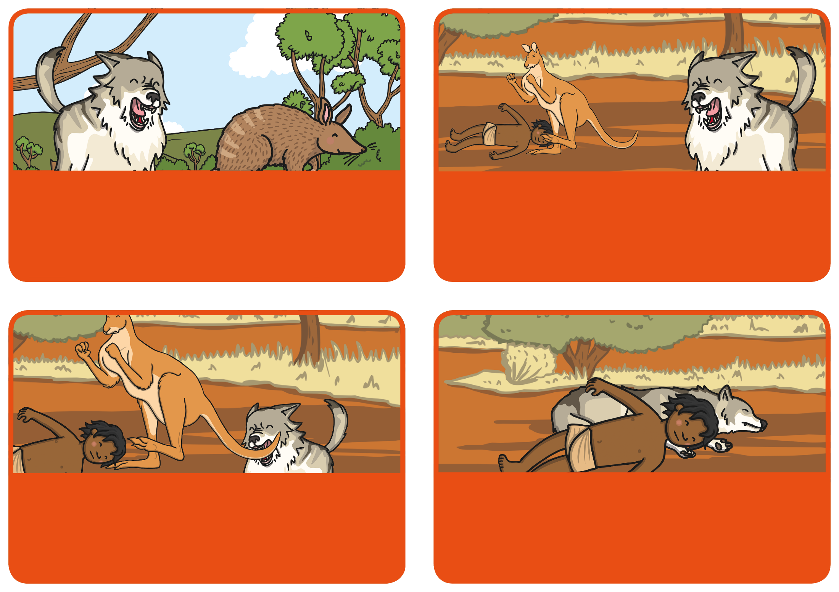
A pup was busy chasing a bandicoot, named Lenira. When the pup heard the boy’s cries, he stopped chasing Lenira and listened. Using his excellent hearing he could tell where the cries were coming from. He went running to see if he could help Palana.

Slide 7
The pup searched and finally he saw Tarner in the distance. He saw Tarner hurting Palana. The pup was brave, he ran towards them and leapt into action. He started to attack Tarner, but Tarner fought back. He tried to stamp the life out of the pup using his strong feet. But the pup didn’t give up and kept biting the kangaroo.

Slide 8
He bit Tarner on the tail, feet and throat, trying to make him let go of Palana. After a while, Tarner became weak and tired and felt he couldn’t fight back anymore. He ran away and disappeared forever.

Slide 9
Palana and the pup were worn out, so they lay on the ground and fell asleep. Thankfully, some people found them and took them back to their camp and looked after them. Palana woke up and saw that the pup was hurt and bleeding. He thought the pup was so brave for what he had done. So, Palana decided to mix some of the pup’s blood with ashes from the fire.

Slide 10
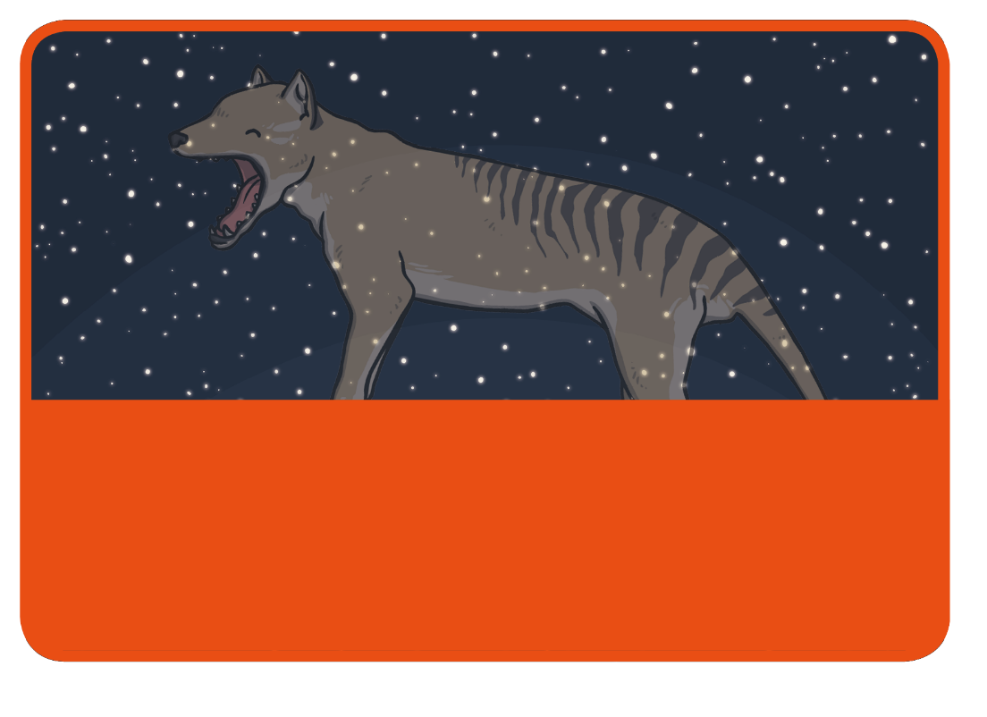
Palana spread the mixture as stripes along the pup’s back right down to his tail. On that day Palana used his power to create the Tasmanian Tiger. Later, the pup could be seen in the sky amongst the stars also known as Gemini. Warrawanna Corinna is still in the skies above Tasmania today.

Slide 11
